Slide 1
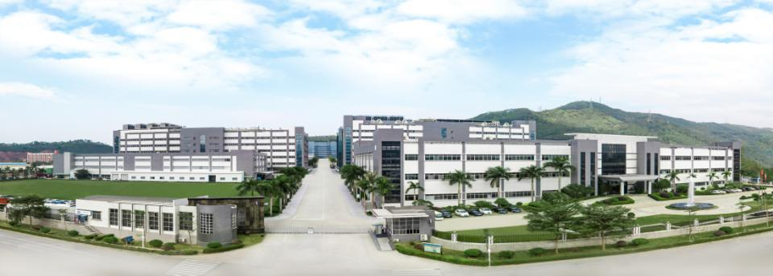

308.03524.055 PCB short to burn analysis report
Prepared by：Kevin Wu
Reviewed by：Jacob Chen
date：2022-03-11
胜宏科技（惠州）股份有限公司
Victory Giant Technology (HuiZhou)Co.,Ltd.

Slide 2
1
Establish the team
目录
2
Problem Description
3
Containment action
Define and Verify the Root Cause
Contents
4
5
PCB and PCBA factors check

Slide 3
D1. Establish the team
角色 | 姓名 | 部门 | 职责
Team Leader | Song Qiang | Quality director | Organize and conduct the team
Team Member | Jacob Chen | Vice manager | Organize the team to analyze and review the case .
 | Kevin Wu | CQE senior engineer | Confirm the review result and the effectiveness of the corrective actions
 | Yang Hua | Quality supervisor | On-site monitor the corrective action to implement , and confirm the improvement result.
 | Xiao Sha | Production supervisor | Analyze the defect , find the root cause , make and implement corrective actions.
 | Wu yong | ME engineer | Analyze the defect , find the root cause , make and implement corrective actions.

Slide 4
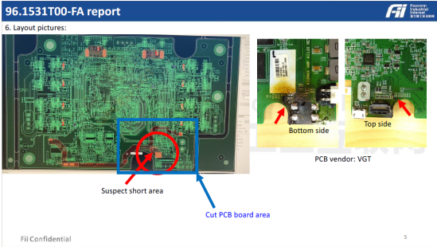
D2. Problem Description
VGT PN | S47304PNM39D2 | Customer PN | 308.03524.055 | Defect | Short to burn
Delivered quantity | 4796pcs | Reject rate | 1pcs/4796pcs=0.02% | Date code | 2136
Failure Mode

Slide 5
D3. Containment action
 | Item | Content | The Responsible
1 | Customer stock | NA | NA
2 | On the way | 0 | NA
3 | VGT stock | DC 2151：154pcs , 100% re-pass E-test | Yujuan Zhong
4 | WIP | 0 | N/A

Slide 6
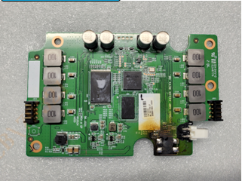
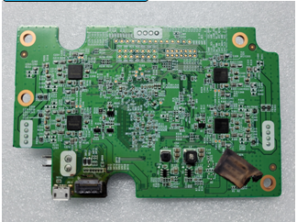
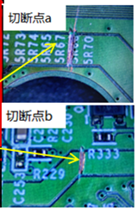
D4 Define and Verify the Root Cause
4.1 Define the rout cause：top side and bottom side of returned defective PCBA
Top side
bottom side
Cutting points
Summary：
The returned PCBA could be observed burned and black some place;
Some component has been removed c
Some circuits has been cut off before VGT received the PCBA.

Slide 7
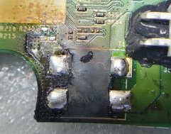
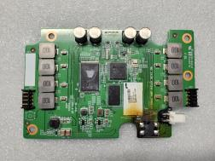
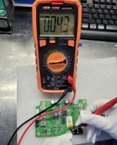
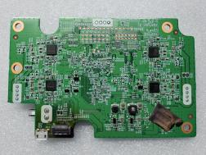
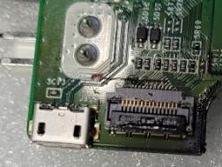
D4 Define and Verify the Root Cause
4.1 Define the rout cause：analyze the returned defective PCBA
TOP side
TOP side：checked circuits and confirmed the short happened in the circuits between A point and B point
Use multimeter to test A point and B point , confirmed short circuit.
A
B
BOT side
BOT side
Summary： the short phenomenon exists and confirmed between A point and B point .

Slide 8
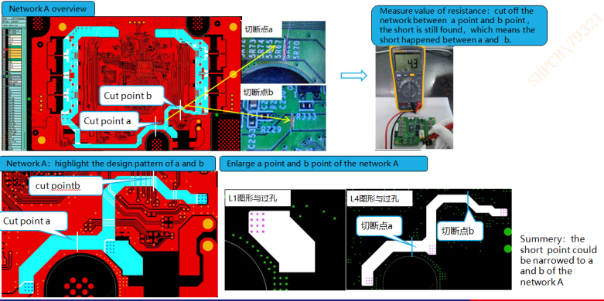
D4 Define and Verify the Root Cause
4.1 Define the rout cause：further analysis

Slide 9
D4 Define and Verify the Root Cause
4.2 Analysis plan
Through above network check, the suspected short circuit is located ,but the PCB was burned , it is hard to find the exact short location.
Here is the analysis plan :
4.2.1 Viewed by E-ray to see through the inner layer of the PCBA ; and find the short location.
4.2.2 Use Thermal imaging method to locate the short ( short point will assemble plenty of hot energy when it is energized , and the hot area will be capture by Thermal imaging equipment) ;
4.2.3 Remove the solder mask and Make horizontal micro-section to analyze ;
4.2.4 Further SEM and EDX analysis ;
4.2.5 Summary ;

Slide 10
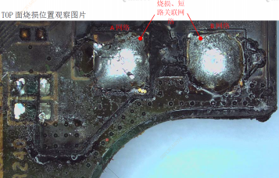
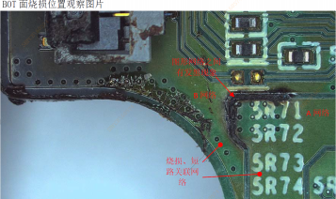
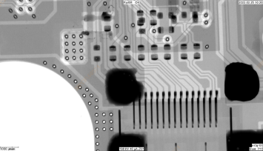
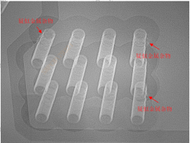
D4 Define and Verify the Root Cause
4.2.1 Define the rout cause ：viewed by X-ray
Vertical X-ray view
Turn 30° X-ray view
X-ray check , see some material around the through holes。

Slide 11
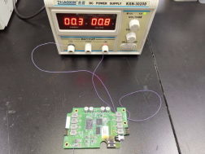
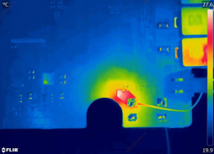
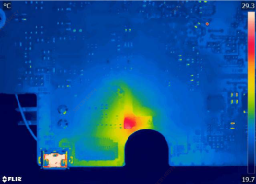
D4 Define and Verify the Root Cause
4.2.2 Define the rout cause ：Thermal imaging check
1）energized 0.3A current to A/B circuit ，to make the short point hot.
2）Thermal imaging device to view the top side : the hot location is in the through hole area.
3）Thermal imaging device to view the bottom side : the hot location is still in the through hole area.
Summary : Through above analysis，the short location should be in the through hole.

Slide 12
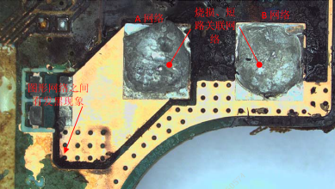
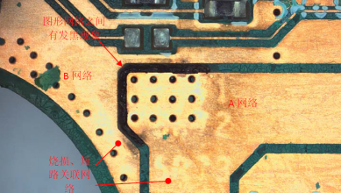
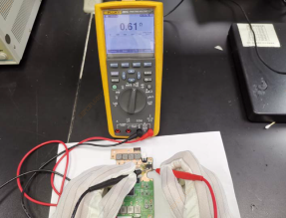
D4 Define and Verify the Root Cause
4.2.3 Define the rout cause ：remove the solder mask.
1）TOP side to remove the S/M and observe the burned location
2）Bottom side to remove the S/M and observe the burned location
3)Confirmed the value of resistance after removing solder mask：
Summary ：
1）Observed the burned surface after removing solder mask , it is seen that the lamination is totally burned , but there is no abnormal material found .
2）Test and confirm the value of resistance , the short still exists.

Slide 13
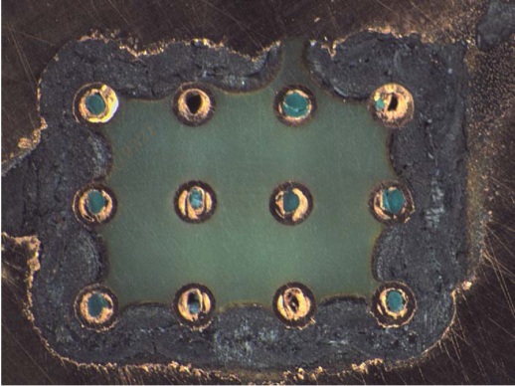
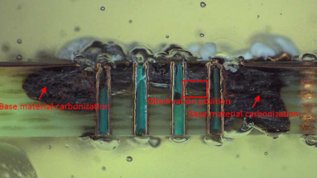
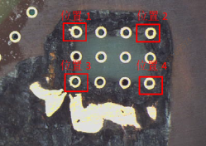
D4 Define and Verify the Root Cause
4.2.3 Define the rout cause ：Make horizontal micro-section to observe
From the micro-section , it is seen that ,around the through holes , the lamination have be burned and black .
The burned area is too large .
some melted copper is found around the 4 through hole.

Slide 14
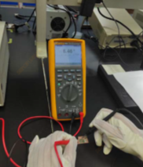
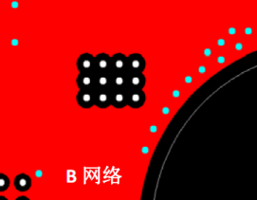
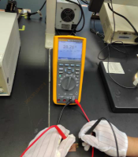
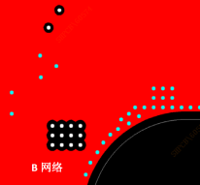
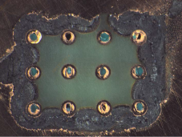
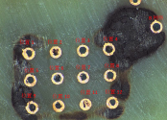
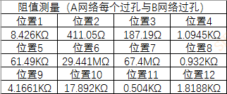
D4 Define and Verify the Root Cause
4.2.3 Define the rout cause ：Make horizontal micro-section to observe
1）Grind off the Top side(L1), the short still exists.
2.1）Observe L2 layer, some melted copper is found around the through hole.
2.2）L2 layer design：
3）Grind off the bottom side( L4 layer) ，test the A,B network , the short still exists：
4.1）Observe the L3 layer , no residual copper is found .
4.2）L3 layer design：
5）Grind off the L3 layer, but leave the L2 layer , test the through holes , which connects A and B netwrok , there still has value of resistance.
Summary ：confirmed that the short point exists in the layer 2

Slide 15
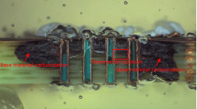
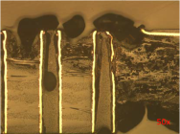
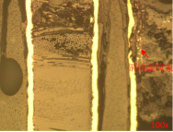
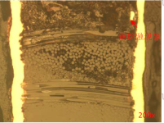
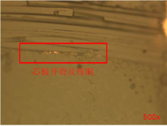
D4 Define and Verify the Root Cause
4.2.4 Define the rout cause ：Further SEM and EDX analysis
SEM observation:
50X
100X, melted copper could be found c.
200X, melted copper could be found in the lamination
SEM observation summary : 500X, the lamination is cracked and melted copper could be found in the crack of the lamination

Slide 16
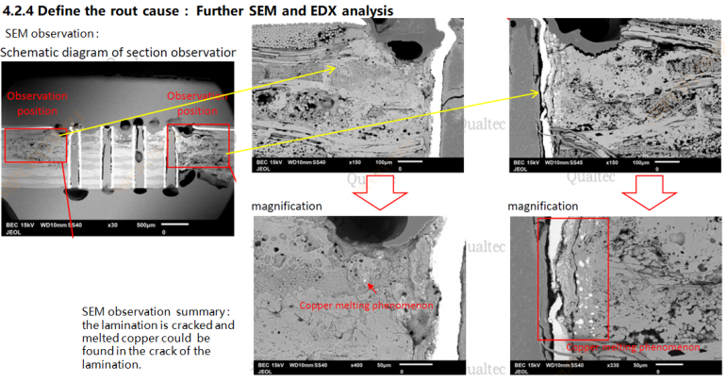
D4 Define and Verify the Root Cause

Slide 17
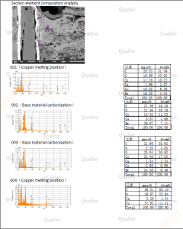
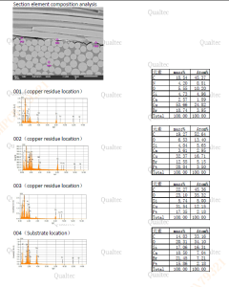
D4 Define and Verify the Root Cause
4.2.4 Define the rout cause ：Further SEM and EDX analysis
EDX analysis :
EDX analysis summary: analyze the material in the crack of lamination , confirmed that it is melted copper.

Slide 18
D4 Summary
4.2.5 Summary
After above analysis to the returned PCBA, summarize as below
1. Why did the board burn ?
because plenty of heat assembly in a short time .short circuit happened;
Why so plenty of heat ?
because of short circuit happened.
Why happened short circuit ?
because (maybe reason 1) some components were abnormal when working , that provided high current or voltage to impact the PCB , even made the copper melted. ( but it is hard to tell due to the components has been removed.)
or (maybe reason 2) some residual copper or some other foreign material in the PCB could also lead to short .

Slide 19

D4 Summary
4.2.5 Summary
After above analysis to the returned PCBA, summarize as below
1. Some components have be moved off before VGT received the returned PCBA.
2. Used multimeter to check and confirm , short circuit indeed exists
3. Made micro-section and use thermal imaging method to confirm short circuit happen in layer2 , around the through holes.
By SEM , some melted copper could be found around the 4 through holes and in the crack of lamination.
Also , the lamination grew some cracks due to the burning or some other forces such like hot air swelling.
5. EDX analysis to confirm the material in the crack of lamination is copper .
6. Large burned area could found on the board surface , circuits , components ,and the lamination around the through holes .
Thus, the summary could be that ,the root cause that lead to the short circuit might be the below 2 ways:
Cause 1 : FA analysis shows that around the holes , some melted copper lamination crack are found , maybe something suddenly happened to the components ,which was abnormal when devices or components working,
Such as some kind of sudden high current or high voltage by external force , or some components were unstable.
Cause 2: Residual copper or other materials in the PCB also might lead to short .

Slide 20
D5. PCB factors check
5.1 PCB factors
5.1.1. PCB flow chart
Sheet Cutting
Inner layer
/AOI
Lamination pressing
drilling
Outer layer/AOI
Solder mask
legend
Packaging
FQC/OQC
OSP
E-test
routing
If The short point is in the layer 2 , which is inner layer.
Inner layer flow chart
Pre-treatment
Film coating
Exposure
Developing
Etching
Stripping
Inner layer AOI
If there is residual copper in the inner layer , there might be 2 ways ,
1. That may happen in the etching process, under-etching could happen but it will occasionally happen, so it mainly depends on AOI to detect and VRS to repair ;
2. Conductive material might fall on the inner layer before lamination pressing.
In the next pages , VGT will analyze the inner layer and the pre-treatment of the lamination process.

Slide 21
D5. PCB factors check
5.2 Inner layer factors
section | Possible factors | Criteria | result | remark
Pre-treatment | NA | Board surface must be clean | excluded | The circuit has not be etched yet, no impact .
Film coating | follow working instructions to produce | Per MI and WI | excluded | NA
Exposure | follow working instructions to produce | Per MI and WI | excluded | NA
Developing | follow working instructions to produce | Per MI and WI | excluded | NA
Etching | follow working instructions to produce | Per MI and WI | excluded | Check the returned board ,circuits are completed , excluded.
Stripping | follow working instructions to produce | Per MI and WI | excluded | Check the returned board , no coating stayed.
AOI | follow working instructions to produce | 100% AOI scanning | excluded | NA
VRS | follow working instructions to produce | defects were repaired. | NG | May lead to leak out

Slide 22
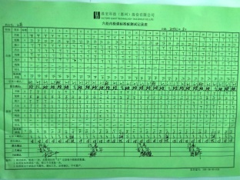
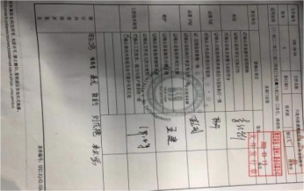
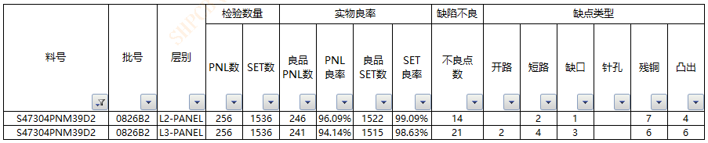
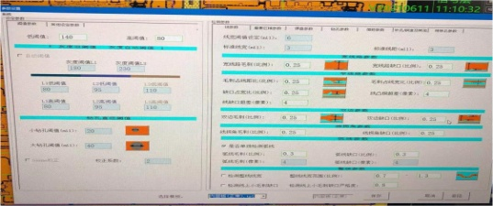

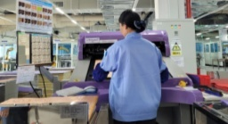
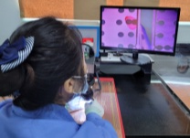
D5. PCB factors check
5.3 Inner layer AOI and VRS checking ：
 | Factors | Result | Record | remark
1 | operators | all AOI operators are all trained and tested before working, and learn about working instruction. |  | OK
2 | pass rate Target | The pass rate Target of inner AOI : 97.5% L2 pass rate 99.09% , pass; L3 pass rate 98.63% , pass; |  | OK
3 | AOI setting | All AOI machines parameters are following WI. April 26th ,2021 ,AOI process scanned 256 working panel of this date code ，recorded 256 panel , no missing AOI； |  | OK
4 | VRS checking | After AOI , VRS station will verify and repair the defective locations, which are found by AOI. |  | NG
From above internal checking , the inner layer production process is OK, but the VRS station may miss some defects and lead to leak out.

Slide 23
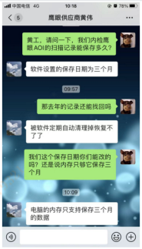

D5. PCB factors check
5.3 AOI data storage ：
 | Factors | Result | Record | remark
1 | Machine | AOI scanning machine could keep the scanning defective records , but it is set to clear up the memory within 3 mouths automatically. |  | OK
The defective date code is DC2136 , which is April, 2021 ,so the records has been cleared up.

Slide 24
D5. PCB factors check
5.4 Summary for inner layer
From above analysis , in the inner layer process , there might be under-etching to create residual copper in the inner layer ;
AOI is capable to find all the inner layer defects , and transfer to VRS station for repair;
VRS station will follow AOI pictures to repair , but some operators might miss some defect locations and lead to leak out.

Slide 25
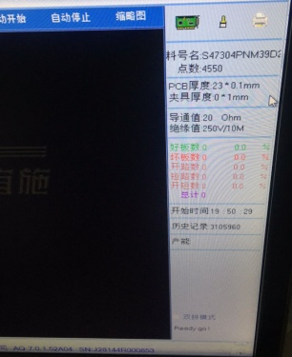

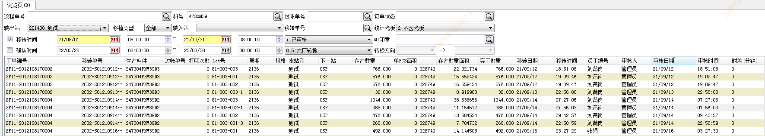
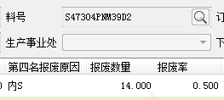

D5. PCB factors check
5.5 E-test factors：
 | item | requirement | Checking result | Record | remark
1 | E-test parameters | Insulation voltage：250V Conduction value≤50Ω Insulation value：10MΩ | all E-test parameters are Within the control range |  | OK
2 | production | all 4180 pcs of DC2136 were E-tested. | E-test detected short failure：14 pcs MRB scrap record：14 pcs |  | OK
内短报废记录：
测试找点记录：
Summery ：this batch was 100% E-tested , no escape.

Slide 26


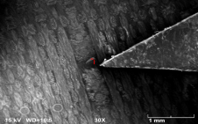

D5. PCB factors check
5.5 (1) Analysis of the short found by E-test.
Part number | DC | E-test quantity | Short quantity | layer | quantity | Failure rate | Pass rate | result | Defect description | FM
308.03524.055 | 2136 | 4180 pcs | 14 pcs | L1 | 5 | 0.2% | 94% | pass | Metal fragment Of inner layer
 |  |  |  | L2 | 1 | 0.02% | 94% | pass
 |  |  |  | L3 | 2 | 0.047% | 94% | pass
 |  |  |  | L4 | 6 | 0.014% | 94% | pass
(2) EDX to analyze the metal fragment ：Cu,Zn compound，which might fall on the inner circuits after brown oxidation line and before lamination pressing , and lead to short .
Elt. | Line | Intensity (c/s) | Conc. | Units | MDL 3-sig
O | Ka | 3.21 | 2.124 | wt.% | .488
Cu | Ka | 23.83 | 61.923 | wt.% | 1.387
Zn | Ka | 10.00 | 35.953 | wt.% | 1.862
 |  |  | 100.000 | Wt.% |  | Total

Slide 27
D5. PCB factors check
5.5 E-test found open/ short
(3)According to the analysis of open/short found by E-test , the short material came from lamination pressing process ( please refer to Page20 for PCB flow chart)
Flow chart of lamination pressing process
Brown oxide process
Board collection
Pre-layout
Lamination pressing
PP cutting
(4) That is why after the AOI scanning , PCB workshop will still set E-test to detect the open/short issue.
(5) Some inner shorts could be detected by E-test , in the upcoming pages ,VGT will analyze the sources of the conductive materials .

Slide 28




D5. PCB factors check
5.6 The sources of conductive materials found in E-test
From above analysis , this kind of conductive materials may happen before lamination and after inner AOI.
 | Factors | requirement | Actual | Proof | Remark
1 | Post-treatment of brown oxide: equipment may be worn to make some metal broken to become metal chips | The post-treatment line operates normally | Checked and found no metal chips from the equipment. And after brown oxide, there is a vacuum cleaner in front of the plate, and the cleaner is normal. |  | excluded
2 | After brown oxide, the retractor might be worn and fall off metal chips. | The equipment shall be free from worn and metal chips | Checked and found that the suction rod of the plate retractor was worn off. The collected samples were cash yellow under mircoscope( similar to the inner short section). The composition of the metal chips were analyzed by EDX and was consistent with the inner short section. |  | NG

Slide 29


D5. PCB factors check
5.6 The sources of conductive materials found in E-test
From above analysis , this kind of conductive materials may happen before lamination and after inner AOI.
 | Factors | Requirement | Actual | Proof | Remark
3 | PP cutting machine fell off metal debris . | The equipment shall be free from worn and metal chips | Checked the PP cutting station , the cutting machine used a steel knife to cut PP , PP is soft , it is impossible to make metal debris. |  | Excluded
4 | There are metal chips polluting the plate surface in the PP pre-stack position | There is no metal debris polluting the plate surface in the PP pre-stack position. | Only operators in the PP pre-stack position , no machine or metal touches the plate. | / | Excluded
5 | The stack position might have metal debris. | There is no metal debris to pollute the plate surface in the stack position. | This is a manual-stack position , and the core boards(inner layer) are already covered by PP . There is no way to fall metal debris to the core boards. |  | Excluded

Slide 30




D6. Permanent corrective action
6.1(1) In order to prevent failure to leaking out , require to 100% AOI re-scan the PCB after verification& repair.
(2) revise the working instruction sheet .
 |  |  |  | Proof
before
after

Slide 31

D6. Permanent corrective action
6.2 Make quality notice to train the AOI operators

Slide 32

D6. Permanent corrective action
6.3 Require IPQC to monitor the VRS repaired boards to go through 100% AOI re-scan.
and revise the VRS report form to add “IPQC signature”.

Slide 33


D6. Permanent corrective action
6.4
 | Before | After | Resp. | Finished time | Proof
1 | The suction rod of the plate collector is made of zinc copper alloy | 1）in short-term action：Dust collecting tray and dust sticking paper shall be installed under the suction rod, and the position shall be cleaned in each shift. 2）In the long-term action：Replace the suction rod of the plate retractor with wear-resistant Teflon material. | 1）short-term Resp.：Man Yang 2）Long-term Resp.：Wu Tao | 1）Short-term：until Nov. 2021 ; 2）long-term：The second quarter of 2002
The suction rod shall be equipped with a tray, and the suction rod shall be cleaned in each shift.
Trial use of Teflon suction rod

Slide 34
D7. Prevent
(1) VGT standardize the corrective actions and implement immediately by PQE .
(2) The cutting week is DC 2212.
(3) VGT will follow 3 months or continuous 3 bathes to check the effectiveness.
Person Responsible：PQE Yang Hua
CQE Kevin Wu

Slide 35

D8. Congratulation.
只有创新发展
才能走向未来
只有创新发展
才能走向未来
谢 谢！
谢 谢！

